Slide 1



The Foot Locker
“in-store” exclusive experience
Mandy Nap 252015
Xiao Xiao 536608
Sabrina Haarmann 536181
Sina Yasinovska 536180
Jessica Wegener 536178
Clio Beraldin 519722
MIA – March 25th 2009

Slide 2

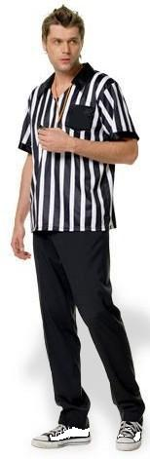



AGENDA
Overview of the current situation
Key challenges to address
Action plan
2 _ MIA – March 25th 2009 – 252015 / 536608 / 536181 / 536180 / 536178 / 519722

Slide 3



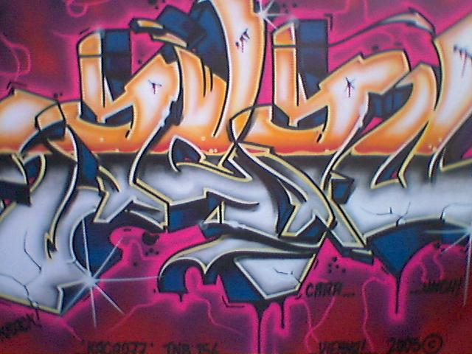
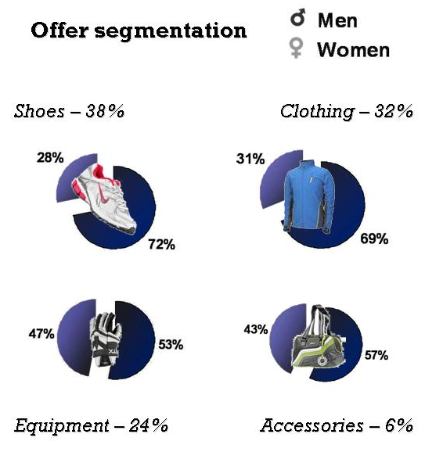

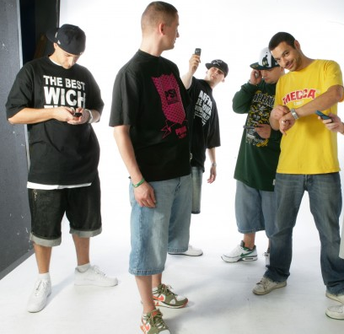

CURRENT SITUATION OVERVIEW
Target segment
Typical profile
  Hip-hop, streetwise fashion style
  Sporty, confident
  Gives strong importance to own image
  “Up-to-date” = Aware of trends
  High need for recognition
  Technology generation
Mostly males
(av.65%)
www.footlocker.com
3 _ MIA – March 25th 2009 – 252015 / 536608 / 536181 / 536180 / 536178 / 519722

Slide 4
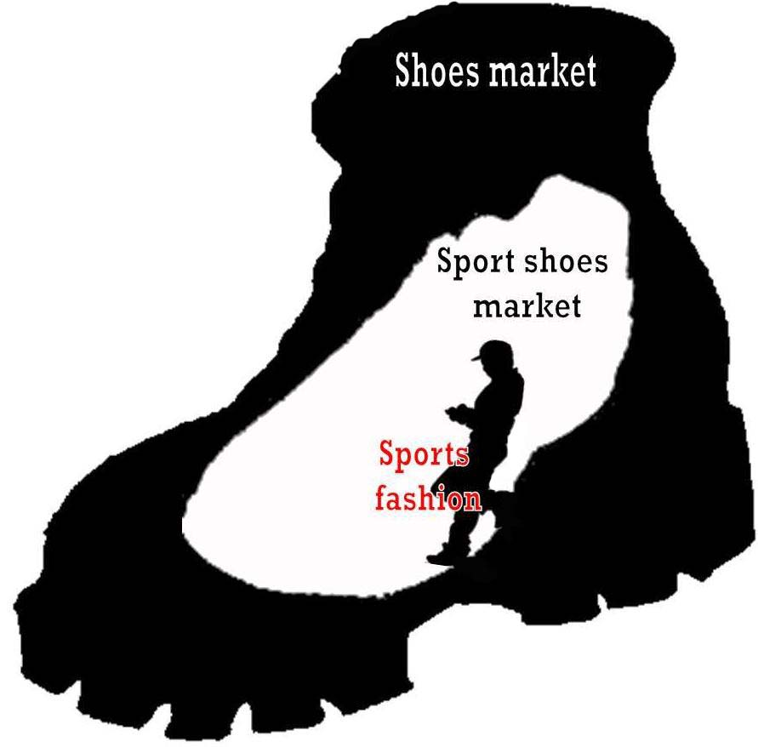
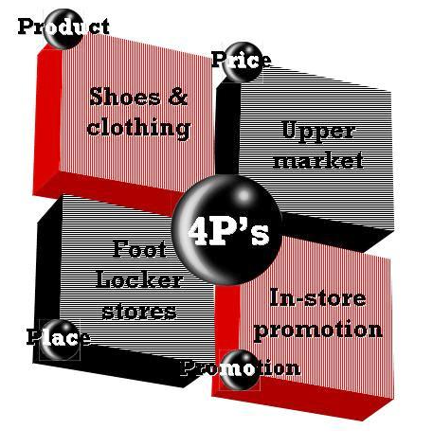


CURRENT SITUATION OVERVIEW
Positioning
Sports fashion ONLY
Narrow target
“MTV of sneakers”
EXCLUSIVE offer
4 _ MIA – March 25th 2009 – 252015 / 536608 / 536181 / 536180 / 536178 / 519722

Slide 5
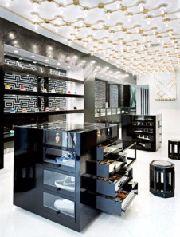
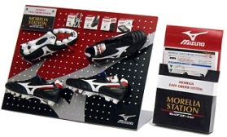
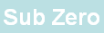
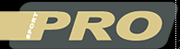
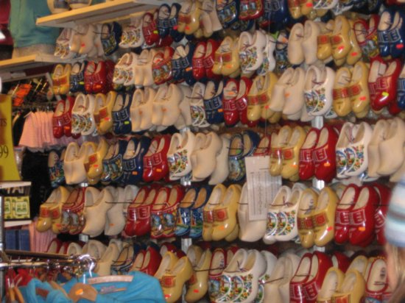
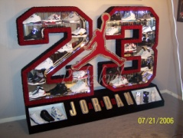
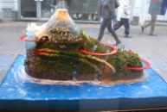

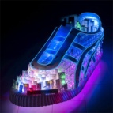
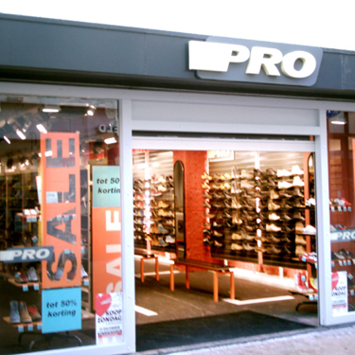
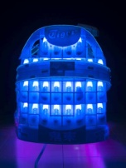
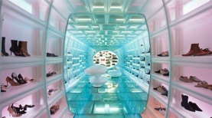
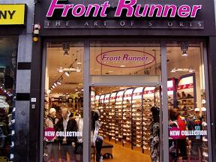

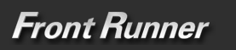
CURRENT SITUATION OVERVIEW
Competitors (Noord Holland)
and others
(local competition)
Strong brand image
Emotional connection
High service level
(availability, sizes)
Good location
Strengths
Cool image
Weaknesses
5 _ MIA – March 25th 2009 – 252015 / 536608 / 536181 / 536180 / 536178 / 519722

Slide 6
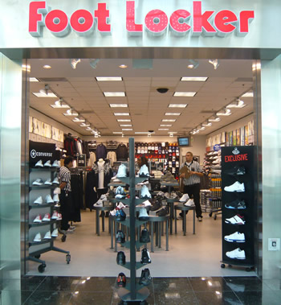
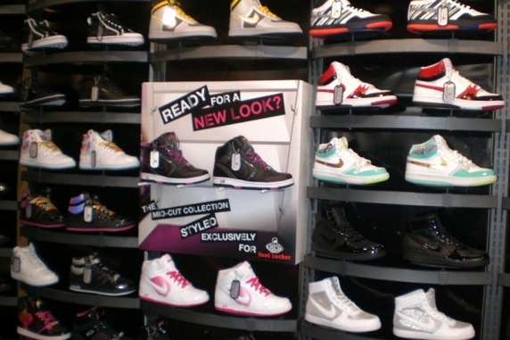
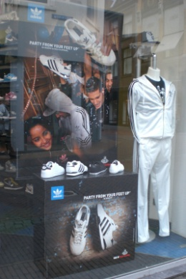
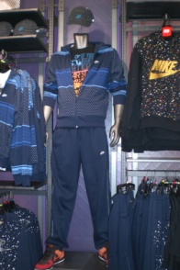
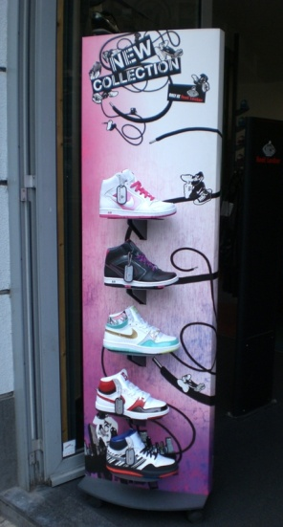
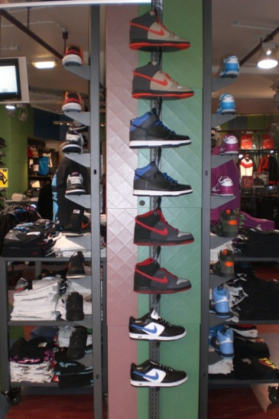
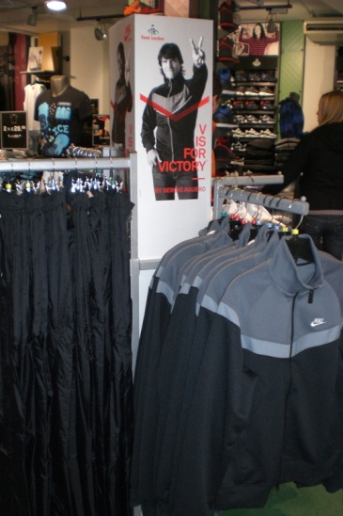
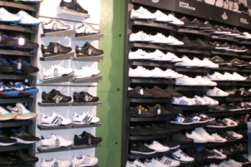
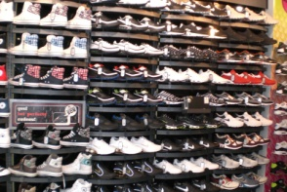
ADDRESSING KEY ISSUES
Foot Locker store layout
6 _ MIA – March 25th 2009 – 252015 / 536608 / 536181 / 536180 / 536178 / 519722

Slide 7
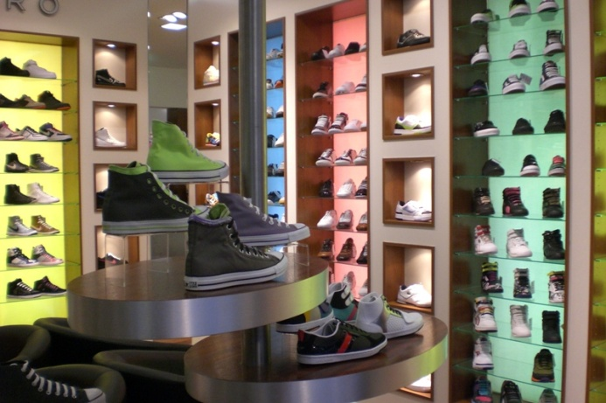
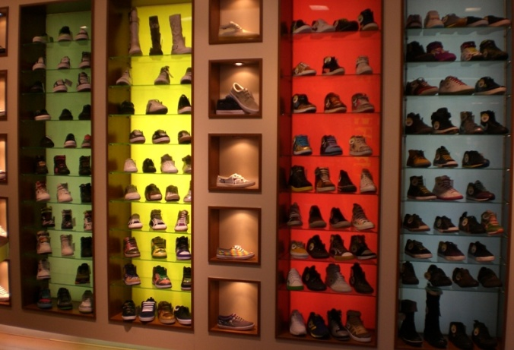
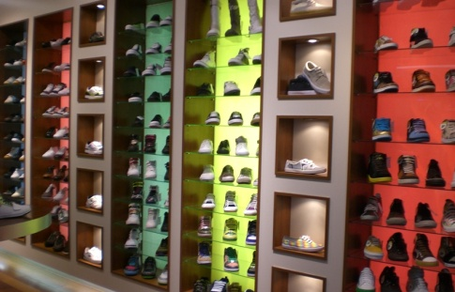
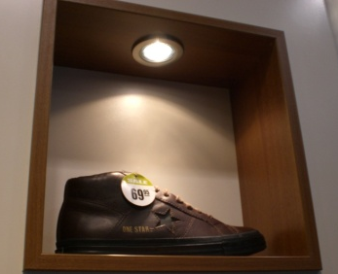
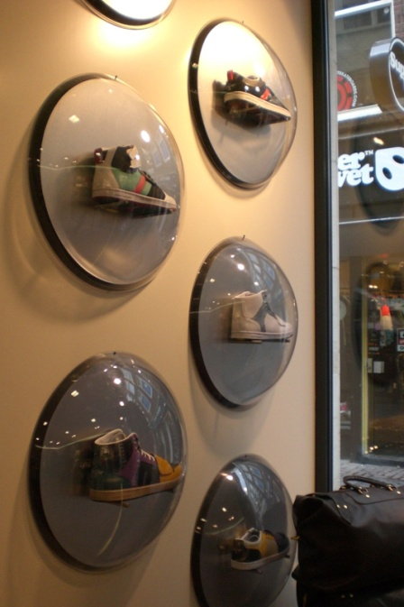
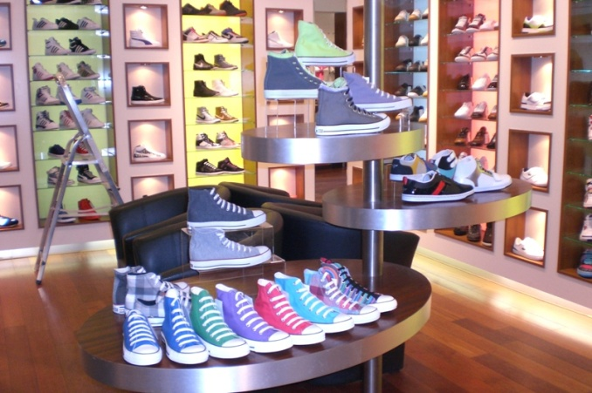
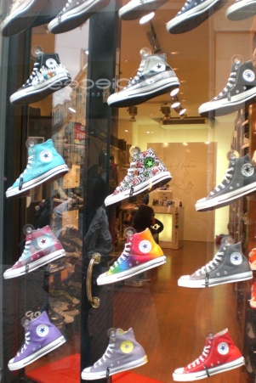

ADDRESSING KEY ISSUES
Competition store layout
7 _ MIA – March 25th 2009 – 252015 / 536608 / 536181 / 536180 / 536178 / 519722

Slide 8
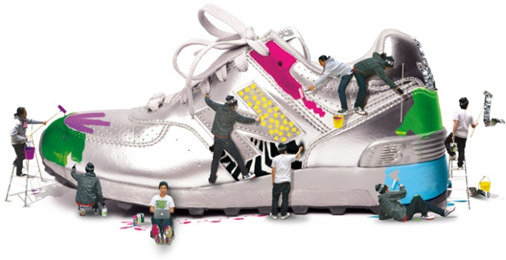

ADDRESSING KEY ISSUES
Challenges
Expanding target segment
  Address “women” in terms of in store merchandising
  Consider 25-35 target (Foot Locker generation)
In-store
communication
Strengthening market position
In-Store
merchandising
  Functional: highlight shoes exclusivity
  Symbolic: assess affective fulfillment
  Experiential: develop & improve sensitive and cognitive stimulation
Boosting competitiveness
  Improve in-store visibility product highlights
  Be cooler, master technology
Technology
8 _ MIA – March 25th 2009 – 252015 / 536608 / 536181 / 536180 / 536178 / 519722

Slide 9
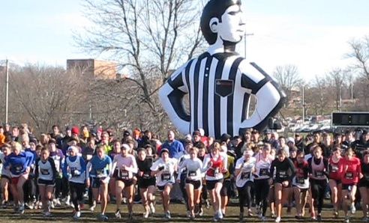
Thank you
for your attention
We hope you enjoyed !
Questions
are welcomed
Mandy Nap 252015
Xiao Xiao 536608
Sabrina Haarmann 536181
Sina Yasinovska 536180
Jessica Wegener 536178
Clio Beraldin 519722
MIA – March 25th 2009

