Slide 1






THE Dutch Camping experience
Mandy Nap 252015
Xiao Xiao 536608
Sabrina Haarmann 536181
Sina Yasinovska 536180
Jessica Wegener 536178
Clio Beraldin 519722
1 MIA - April 20th 2009
252015 / 536608 / 536181 536180 / 536178 / 519722
Notes:
Welcome at Ardoer, THE Dutch camping experience.
Today, MAX’s J.C. is proud to present you its proposal to reach the ambitious increase of 100% in the 16-35 target group.
Our agenda for today …

Slide 2
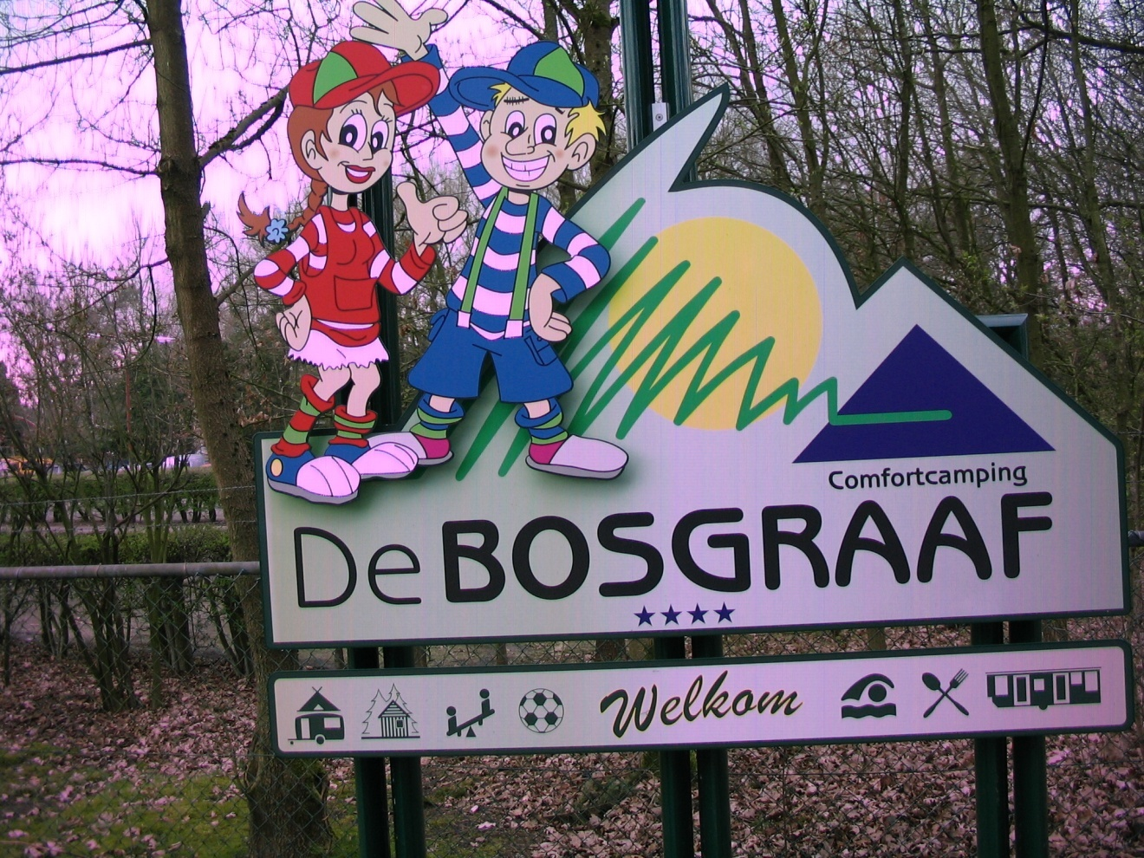
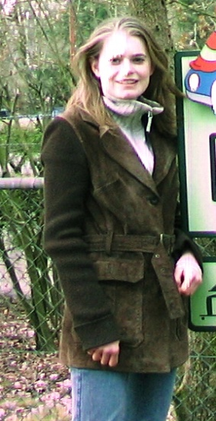
Mystery Guest of the team
Unfortunately could not be here to test the feasibility of one of the Ardoer campings’ concept.
2 MIA - April 20th 2009
252015 / 536608 / 536181 536180 / 536178 / 519722

Slide 3
Agenda
Overview of the current situation
Strategic profile
Strategic analysis
Key issues to address
Objectives
Action plan milestones
Marketing plan proposals
Yin Yang
7/5
4D
3 MIA - April 20th 2009
252015 / 536608 / 536181 536180 / 536178 / 519722
Notes:
We’ll start with a rapid overview of the current situation which will lead us to the key aspects to consider in order to reach Ardoer’s goal
Then, you be introduced to 3 different alternatives of the new Ardoer concept.
Let’s start by drawing a brief strategic profile and analyzing it more in debts. (NEXT SLIDE)

Slide 4
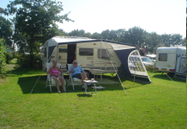




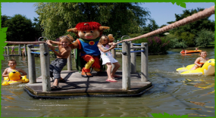

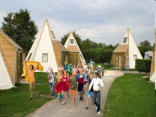




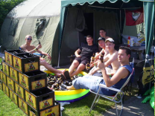





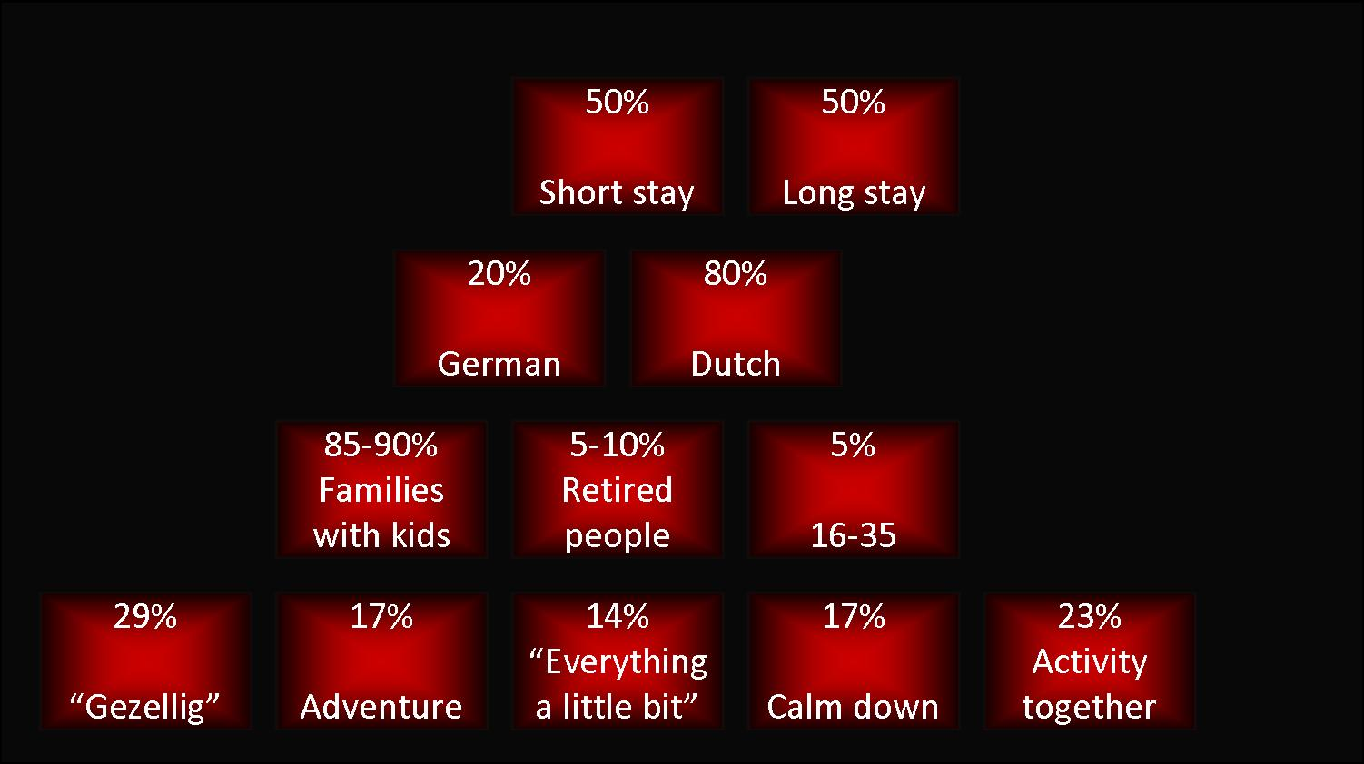
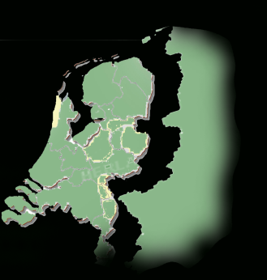
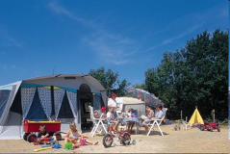

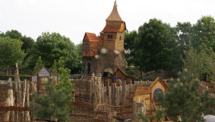



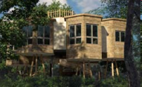
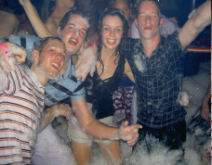
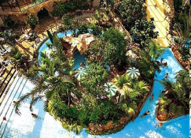
Strategic profile
Brand image
According to Ardoer, brand image stands for
Holidays in Holland
Ultimate outdoor experience
Quality
Hospitality
Passion
Competition
DIRECT
Holland Tulip Parks
Dutch partner of camping cheque
3-5 star camping sites, premium camping
27 quality camping at the most beautiful spots
Roompot
Tradition of more than 40 years
96 bungalow, 23 campsites and 2 hotels
Biggest provider of holiday accommodation in Holland
Uniqueness of the parks
A lot of activities, packages and combinations
Customers review on site
. . . But PERCIEVED image is different
Old-fashioned
Child oriented
Administrative
Non spectacular
Non exiting
INDIRECT
Camping Appelhof
  Specialized in younger people
  Most popular youth camp in the summer
  Discotheque in the campsite
  Unforgettable party holidays
Camping park de Bongerd
  Specialises in Family Camping
  5 Star Park 5 star camping
  Entertainment & Animation for kids
CenterParcs
  Bungalow Park, Houseboat, Tree house & Hotels
  Germany, Netherlands, Belgium & France
  Privacy & quiet, different activities
  Closer to cities
Target market & target groups
Ardoer is a player on the Dutch outdoor tourism market is recognized on a European level
Segmentation
2 levels of segmentation
Families
Retired people
  Easycamp
  3 – 4 star camping in ten European Countries
  Great camping for small price
  Tents, Caravan, Bungalow, Apartment
  Share experience on homepage
4 MIA - April 20th 2009
252015 / 536608 / 536181 536180 / 536178 / 519722
Notes:
Ardoer unifies its brand image around strong values: quality, hospitality, passion.
That’s one of the main reason why the Ardoer camping sites have been successful until now: camping experience at Ardoer is great and customers come back.
But looking at the purchasing process, it seems that Ardoer does not currently offer neither pre-purchase nor purchase experience that could stimulate 16-35 target especially the online platform.
It is the main distribution channel and its traffic increase belongs to our objectives, but a problem appears: obviously, Ardoer dedicated its online platform to attracting families with kids: Strict and administrative design to attract the buyers (parents), interactive separate domain for the purchase stimulator (children) and separate domain focused on retired people.
About the market Ardoer is operating in, (CLIC)
The strategy is mainly focused on the Netherlands … still 20% of the customers come from close German neighborhoods.
We can identify 4 main target groups based on geographical, offer type, age / social profile and experience segmentation. However (based on the website and observed promotional offers); Ardoer only proposes 2 levels of segmentation, families (focused especially on kids) and retired people.
Let’s now look at the competition. (CLIC)
Sabrina?
All those observations led us to a more precise definition of Ardoer positioning. (NEXT PAGE)

Slide 5
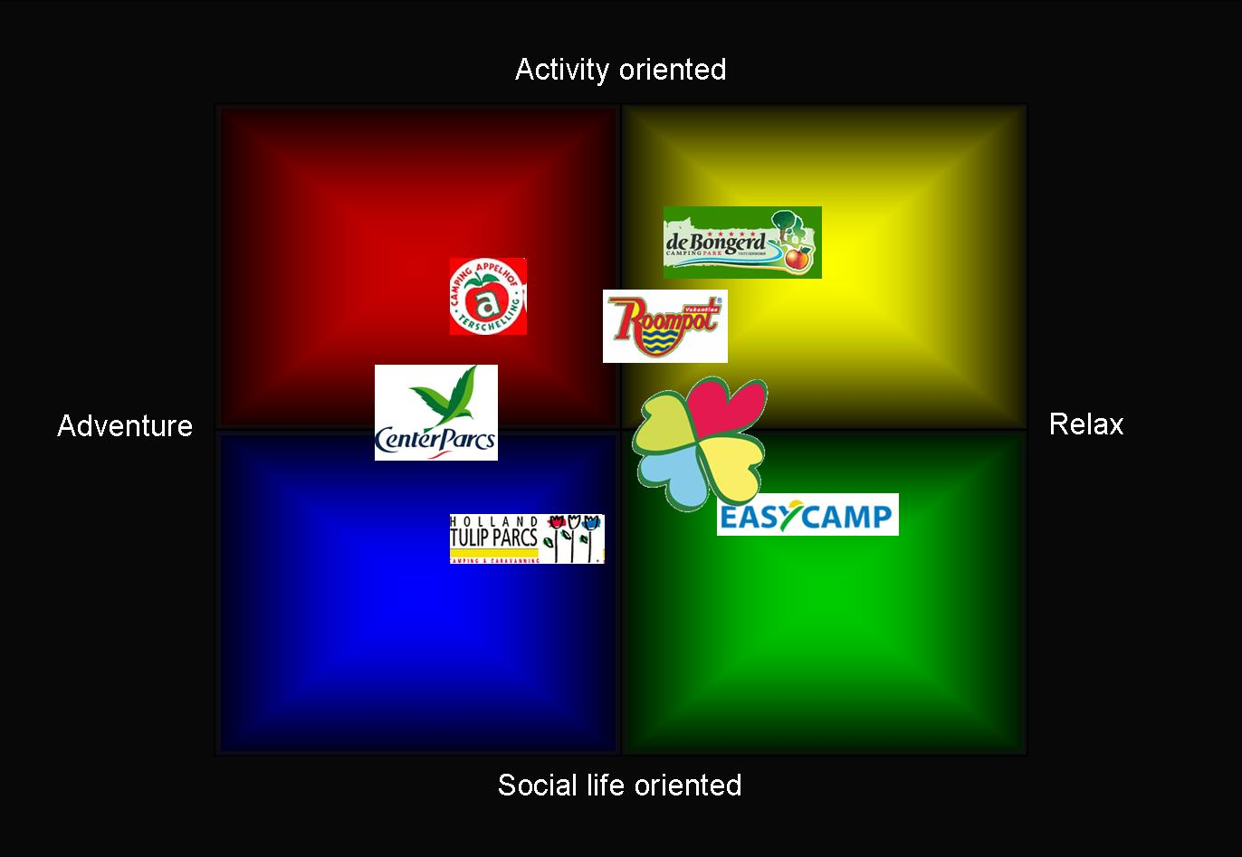
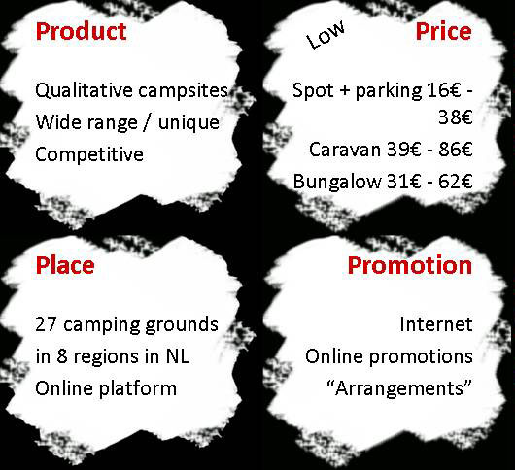
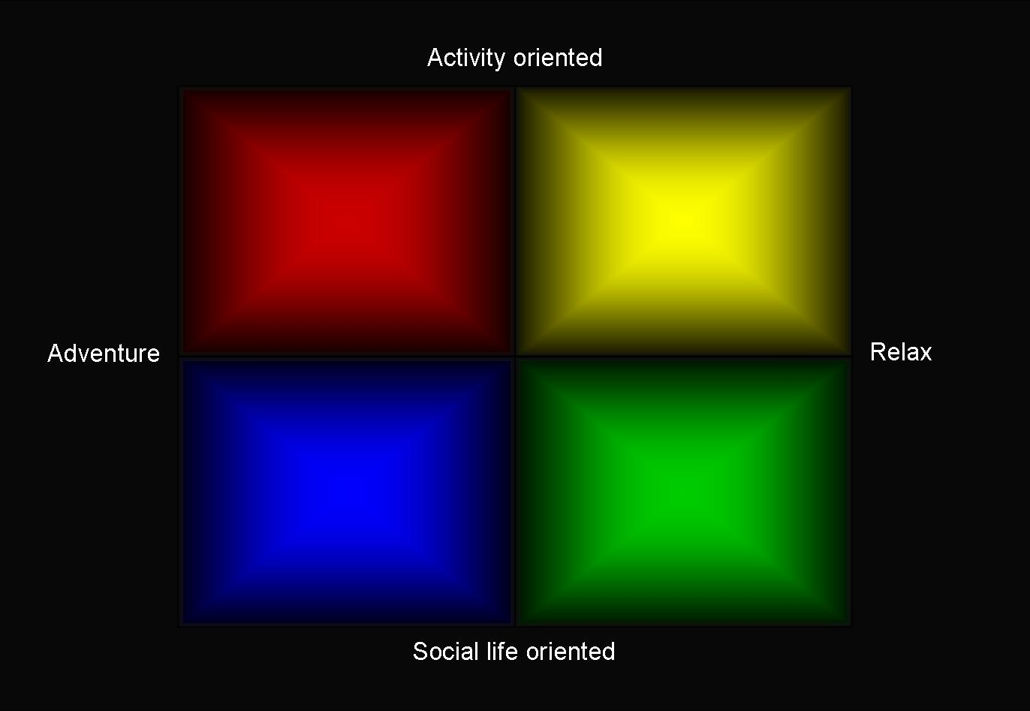

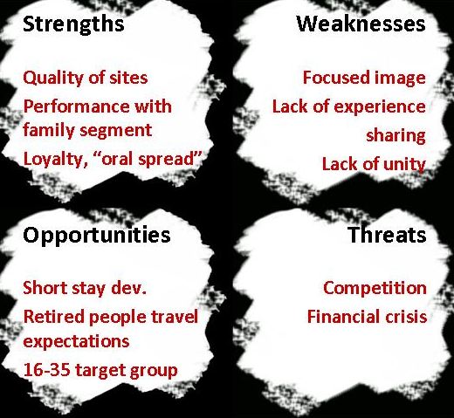
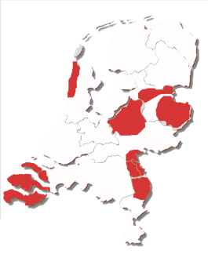
Strategic analysis
4P’s
Positioning
Trade faires
Radio
Swot
Website
Ardoer is performing well on the family segment but its current strategy is too much focused to develop 16-35 target group, especially in the highly competitive environment
The concepts should aim at repositioning Ardoer as a more adventurous, activity oriented brand ( // Appelhof)
5 MIA - April 20th 2009
252015 / 536608 / 536181 536180 / 536178 / 519722
Notes:
After a brief summarize of the marketing MIX, we could identify the main S/W/O/T of Ardoer and use it as a starting point for further developing the concept.
As a result, (CLIC)
Ardoer can be described as an “almost in the middle company”, due to the gap between existing offer and perceived image:
on the one hand Ardoer has the ability to provide the 26-35 target group with attractive offers matching their needs,
on the other hand, the image ‘spread especially through the website) is only focused on families, relaxing & comfort and quality time together.
Therefore, without leaving the family and retired people target groups, (CLIC)
we would strongly advise Ardoer to investigate a repositioning toward a more “wild image”, and find the right balance to keep satisfying its main target groups.
After the short analysis, let’s have a look at the objectives we want to reach. (NEXT PAGE)

Slide 6







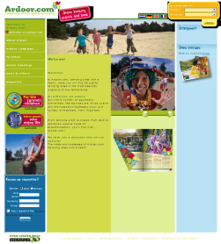
Objectives
Quantitative
Reach 100% increase of 16-35 target group (50 000 to 100 000 customers)
Increase online sales
Qualitative
Develop brand image perception
Create online Experience platform
HOUSTON,
We have Solutions !
Key issues
Address 16-35 target
segmentation approach ?
promotional approach ?
Maintain & improve performance of current target groups
right balance ?
Website
improve or Change ?
increase traffic & online booking?
Offline
Online
6 MIA - April 20th 2009
252015 / 536608 / 536181 536180 / 536178 / 519722
Notes:
The 16-35 segment currently represents 5% of Ardoer’s customers.
We want to meet 10% of that population by the end of the 2010 season.
From a qualitative point of view, we pointed out that it is essential to change the brand image perception.
This step can not be put apart from radical changes in the website and the current brand image.
Key issues that we will have to face will be
first, Which segmentation approach would best stimulate 16-35 target? How effectively promoting the brand?
Then, How to implement 16-35 concept with it being to the detriment of the current target groups?
And finally, also from a financial point of view, to which extent should implement those changes?
How to do that ?
(HOUSTON …) (NEXT PAGE)

Slide 7

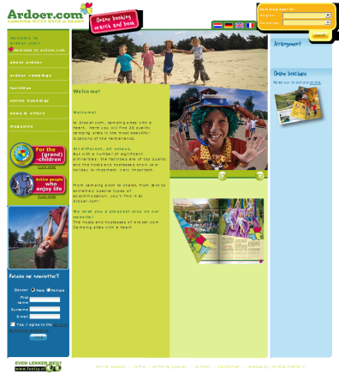
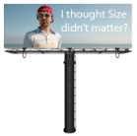
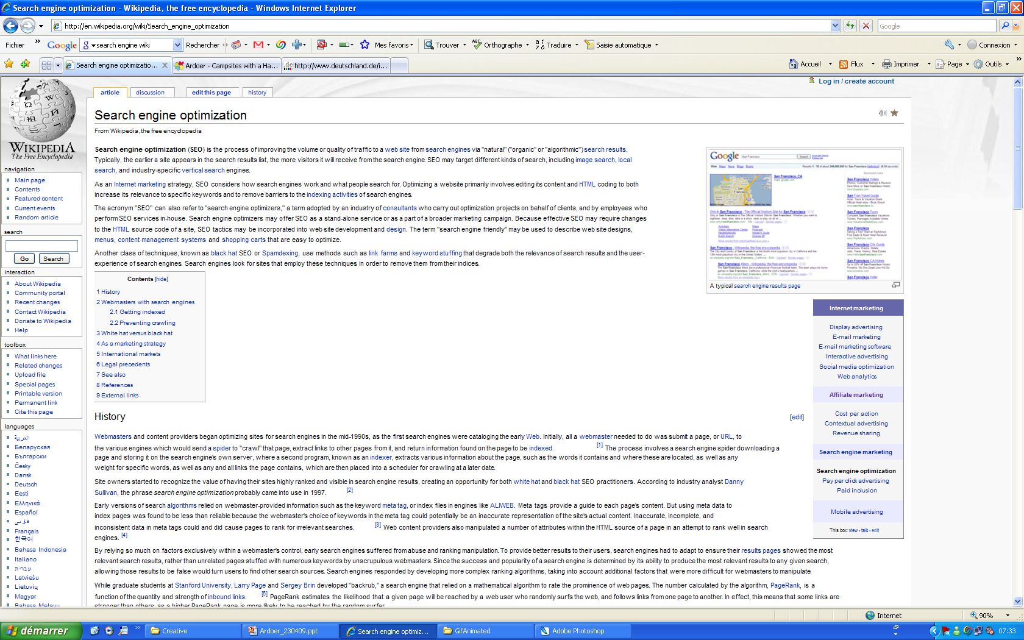


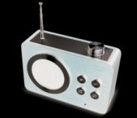
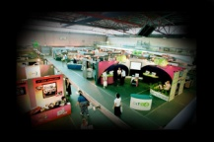


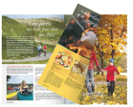




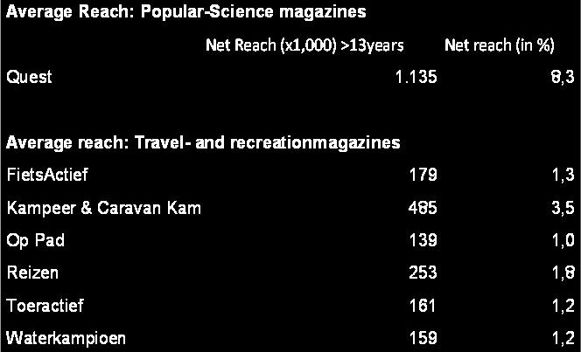











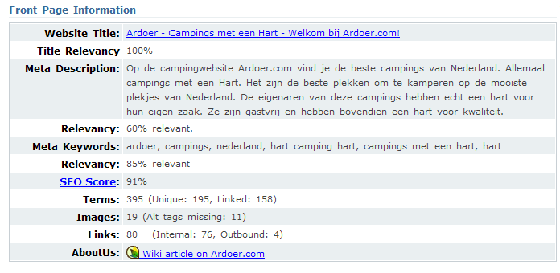

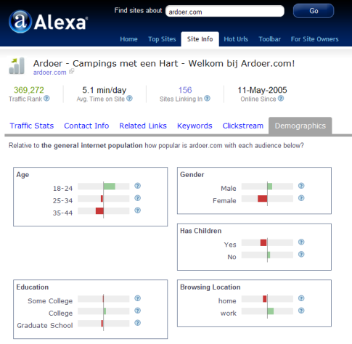
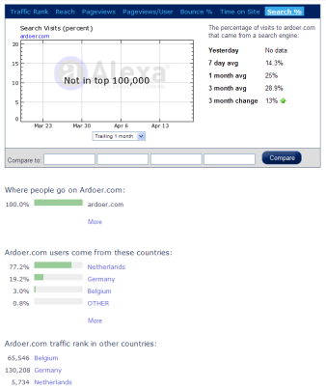
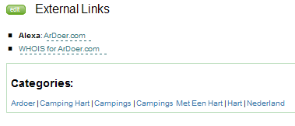
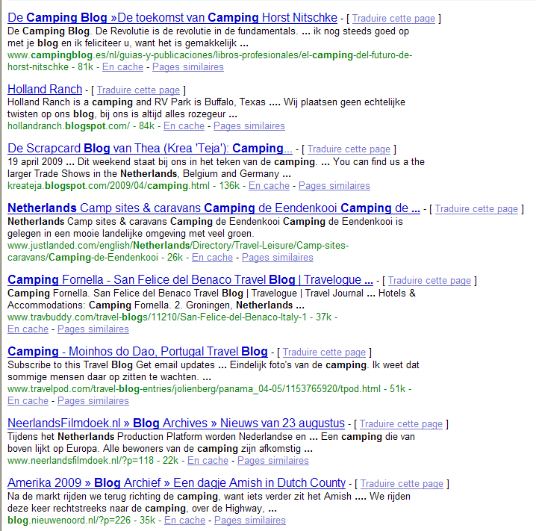
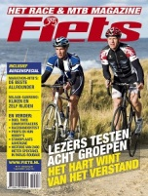



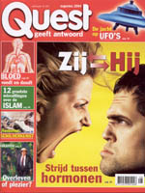



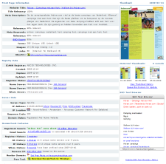

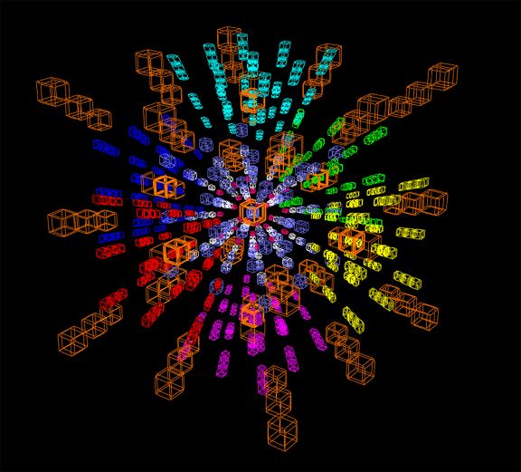
Milestones
Promotional plan
OFFLINE promotions
Trade fairs
Print media
Broadcasting media
Other communication support
ONLINE promotions
Website
Advertising
Blogging
Networking
Update image
Allow customers to dream through Ardoer image
Evasion
Recreation
Adventure
Attract new target segments
Attract 16-35 people, from The Netherlands and from Germany
16-18 = School groups, friends
18-25 = friends, students groups
25-35 = friends, young couples, incentive groups
http://www.affiliatefuture.com/merchants/Default.asp
http://www.cj.com/advertisers/
http://www.google.com/ads/affiliatenetwork/
NL specific affiliation network
http://www.daisycon.com/
http://www.tradedoubler.com/nl-nl/
http://www.tradetracker.net/nl
http://www.m4n.nl/
INTERACTIVITY
Networking = 265 million p
REALISM
EYE CATCHING EFFECT
Brochure (Shorten Online brochure)
Catalogue (existing)
Bus ads
Cinema ads
Billboards (next to Uni / Schools)
On-rent caravans / camping cars
. . .
Kampeer & Caravan Fair in Utrecht
48 396 visitors in 2008
biggest Camping & Caravan Fair of The Netherlands
Expected Reach / season
for 16-35 target group
Expected Reach / season
for 16-35 target group
Promotional offers on the website
Community
Forum
Games
And create THE online platform for outdoor tourism experience
Expected Reach / season
for 16-35 target group
23 to 40 000p
Expected Reach / season
for 16-35 target group
10 to 15 000p
Allow customers to experience “holiday mood” online
Website design
Newsletter & e-mailing
Online advertising
Search engine optimization
Affiliation
Traffic analysis
Expected Reach / season
for 16-35 target group
Develop segmentation strategy
Concept 1 “ Yin Yang ”
Concept 2 “ 7/5 ”
Concept 3 “ 4Ds ”
15 to 40 0000 p
Caravana in Zuidlaren
45 000 visitors each year
8 to 15 000p
5 to 10 000p
Budget forecast
Move Ardoer concept positioning
From “Camping sites with heart” to
“Ardoer, Your welfare at heart”
“Put your heart
into finding the right holidays”
Targeted position: THE camping Experience
Budget forecast
Develop Links and “Win-Win" exchange
Caravan Salon in Düsseldorf
165 000 visitors each year
about Caravans, camping-equipment, tents, camping sites and destinations
5 to 45 000€
Budget forecast
Budget forecast
110 to 245 000€
Budget forecast
4 to 60€ / p
Blogs = content + free ad
Website 100 000€
Free ad
100 to 150 000€
5 to 50 000€
Reise + Camping in Essen
100 000 visitors each year
one of the biggest trade fairs in North Rhine Westfalia
covers the areas of tourism, camping and caravanning
Men 25-50
Women 18-35
Men 18-35
Men
& women
25 +
Men
& women
25-49
7 MIA - April 20th 2009
252015 / 536608 / 536181 536180 / 536178 / 519722
Notes:
Attract target segment => segmentation first level focuses on holiday type – sub segmentation will then be applied for each target group
Update the image thanks to a lifted logo which will express better Ardoer repositioning
… And therefore adapt the strategic direction .. From camping sites with heart to camping sites that move your heart !
In order to achieve those goals, we proposed 3 concepts based on different segmentation approaches
The Yin Yang concept, the 7/5 concept and the 4D’s concept.
We will introduce them to you (CLIC)
through a concept draft of the respective corresponding online platforms
But first, let’s have a look at the general online promotional approach to adopt. (CLIC)
There are many ways to advertise online and Ardoer is using its online opportunities well. How it can be further developed.
Search engine optimization is 1 mean, and Ardoer should both provide enough content and in/out links
to be correctly referenced online. (CLIC)
Affiliation is another way to earn money through your website, and Ardoer should focus on Dutch affiliation networks specialized in outdoor tourism.
Last but not least, (CLIC)
traffic analysis provides the company with extremely valuable information.
A regular monitoring of your website performance and relative reaction are key factors of success for boosting online sales.
And what about the general promotional plan? (CLIC)
First the offline plan.
It includes attending targeted trade fairs, both NL and DT … which as we estimated could bring up 1/5 of our quantitative objecives.
Then, print media communication support. (CLIC)
Here, we advise to focus on media that correspond to our target 16-35, still keeping a general approach. Roughly, a complete implementation of the plan could reach up ¼ of the objective.
Broadcast media tend to be quite ineffective considering the investment.
However, the current strategy of Ardoer should be maintained (local radio ads) (CLIC)
Finally other communication supports, (CLIC)
such as bus ads, or target ads on caravan on rent could be highly effective.
Cinema, because they can our target directly, should one the main focus as well.
All in all, (CLIC)
Offline advertising could bring up to 1/3 of the customers we target.
Let’s now have a brief look at online advertising in the general approach. (CLIC)
4 main support of advertisement (in addition to the ones mentioned previously) are available.
The website it self, to propose special deals …. Search engine optimization with linking concept …. Blogging = look for camping related NL and DT blogs … and Networking !!
All in all (CLIC)
Off line advertisement could bring up to 50% of the customers we want to attract; It is not only effective but also enable costs saving, especially in the current context.
Let us now finally have look into the concepts’ details starting with the Yin Yang concept. (NEXT PAGE)

Slide 8

Thank you
for your attention
We hope you enjoyed !
Questions
are welcomed
8 MIA - April 20th 2009
252015 / 536608 / 536181 536180 / 536178 / 519722

