Slide 1

Customizable
Health / Travel / Liability Insurance
for International Students
Owners
Fred MASANGO
Jin Fan HU
Suife KISITO
Clio BERALDIN

Slide 2
Agenda
Company Offer
Environment (SWOT)
Targets Overview
Financial & Marketing Objectives
Operational Action Plan
Capitalization & Financial Projections
Investors’ benefits

Slide 3
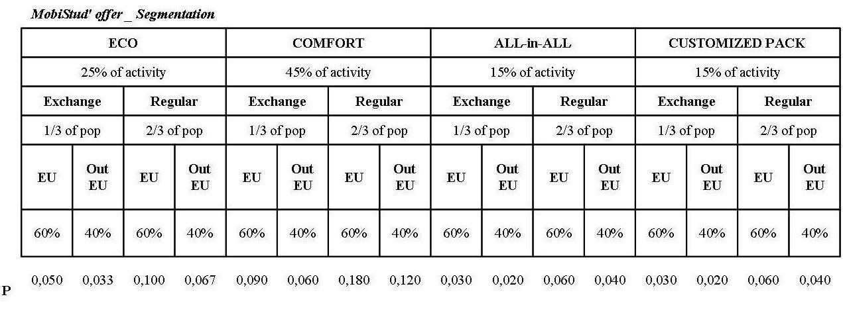
Offer (i)
Context
Insurance package for international students in NL
Mission Statement
Company Offer
Environment
Targets Overview
Financial & Marketing
Objectives
Operational Action Plan
Capitalization &
Financial Projections
Investors’ benefits
Segmentation

Slide 4
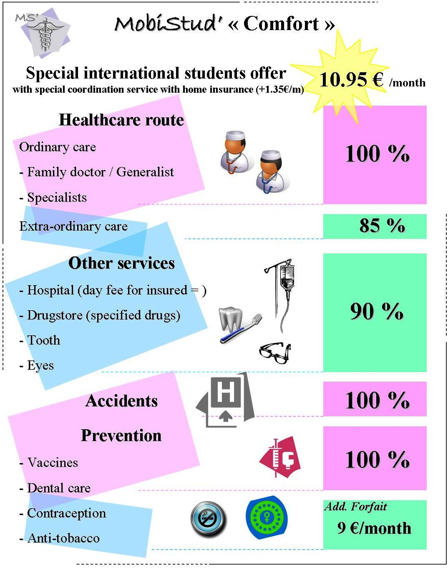
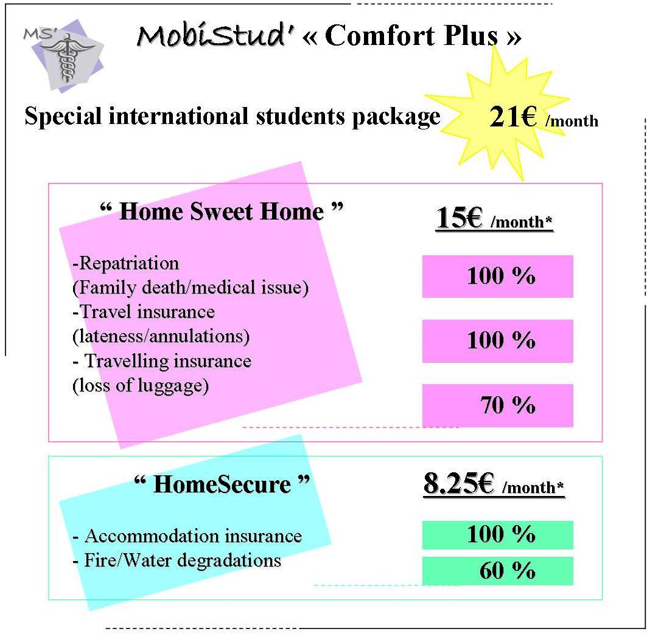
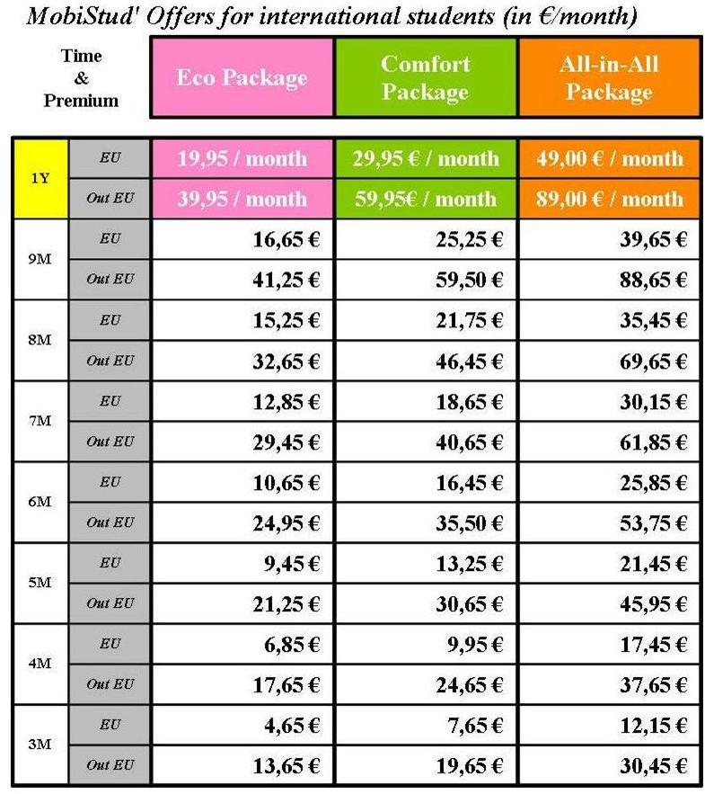
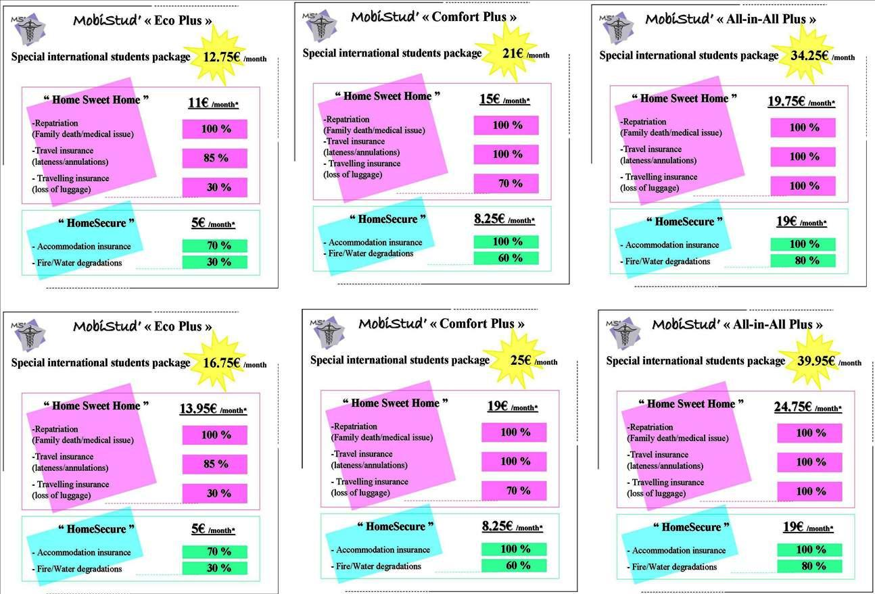
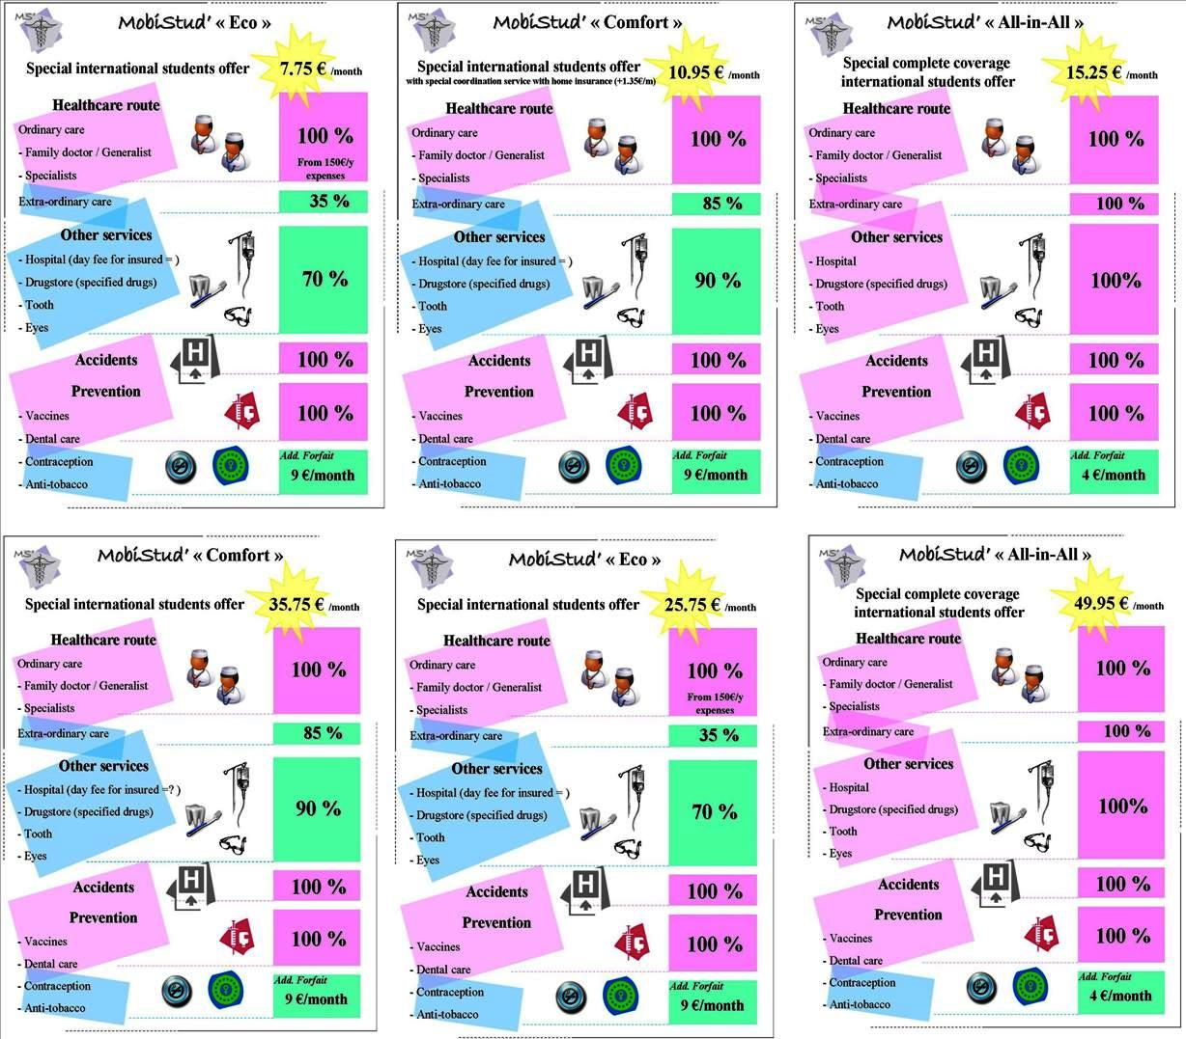
Offer (ii)
Insurance Packages (Standard) Overview
Company Offer
Environment
Targets Overview
Financial & Marketing
Objectives
Operational Action Plan
Capitalization &
Financial Projections
Investors’ benefits

Slide 5
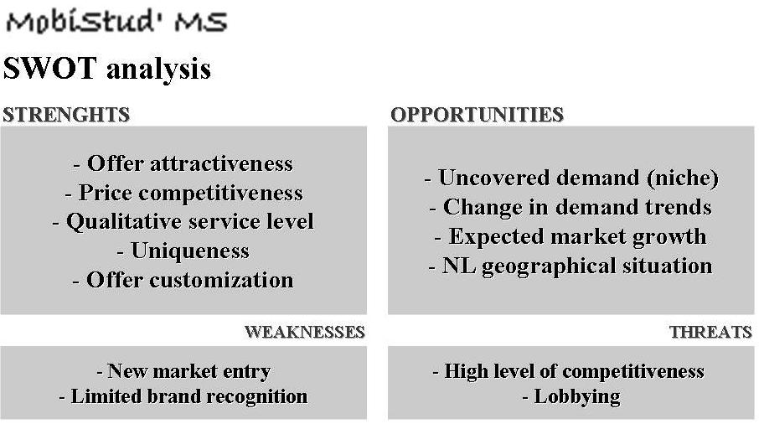
SWOT Analysis & Issues (i)
SWOT
Company Offer
Environment
Targets Overview
Financial & Marketing
Objectives
Operational Action Plan
Capitalization &
Financial Projections
Investors’ benefits

Slide 6
SWOT Analysis & Issues (ii)
Key issues for MobiStud’ to succeed
Best negotiated tariffs and services with suppliers
Networking & Partnerships
ECO, COMFORT, All-in-ALL packages launch
"Coordination" program
Customization program
Affordable, Unique service, Flexible, student insurance
Company Offer
Environment
Targets Overview
Financial & Marketing
Objectives
Operational Action Plan
Capitalization &
Financial Projections
Investors’ benefits

Slide 7
Targets (i)
B2C
International Students in NL (First 5 years)
Company Offer
Environment
Targets Overview
Financial & Marketing
Objectives
Operational Action Plan
Capitalization &
Financial Projections
Investors’ benefits

Slide 8
Targets (ii)
B2B
Students’ Organizations & Institutions
Embassies
Travel agencies
Language institutes
Youth hostels
Housing agencies
Recruitment agencies
(International) Student pubs
University sport centres
Medical institutions / Doctors /Hospitals / Drugstores
Introduction week exchange
Study abroad fair in country where student resides
Company Offer
Environment
Targets Overview
Financial & Marketing
Objectives
Operational Action Plan
Capitalization &
Financial Projections
Investors’ benefits

Slide 9
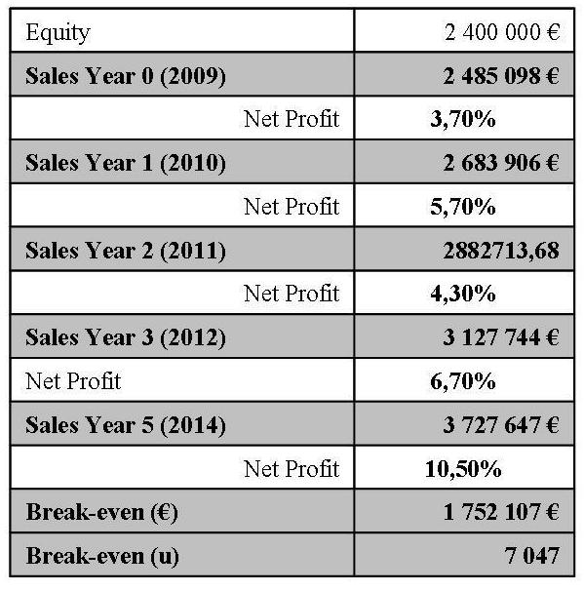
Objectives (i)
Financial Objectives
Company Offer
Environment
Targets Overview
Financial & Marketing
Objectives
Operational Action Plan
Capitalization &
Financial Projections
Investors’ benefits

Slide 10
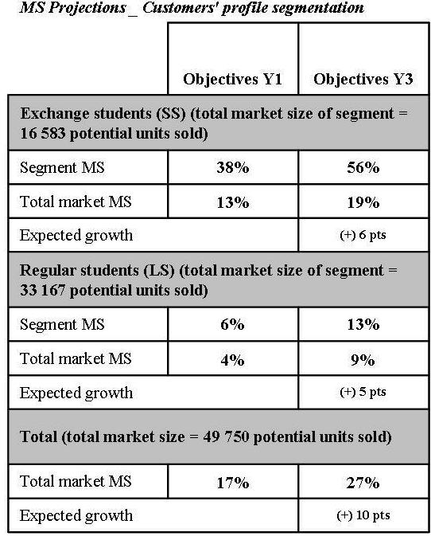
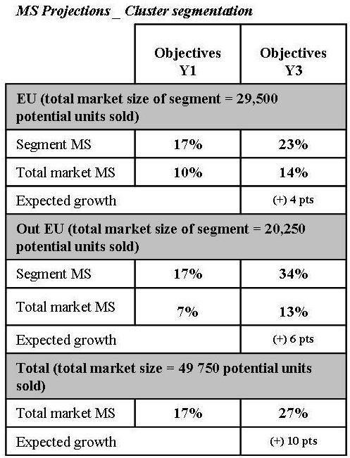
Objectives (ii)
Marketing Objectives
Promotion = Brand awareness
Channels = Websites + Leaflet on partners’ places
MS
Company Offer
Environment
Targets Overview
Financial & Marketing
Objectives
Operational Action Plan
Capitalization &
Financial Projections
Investors’ benefits

Slide 11
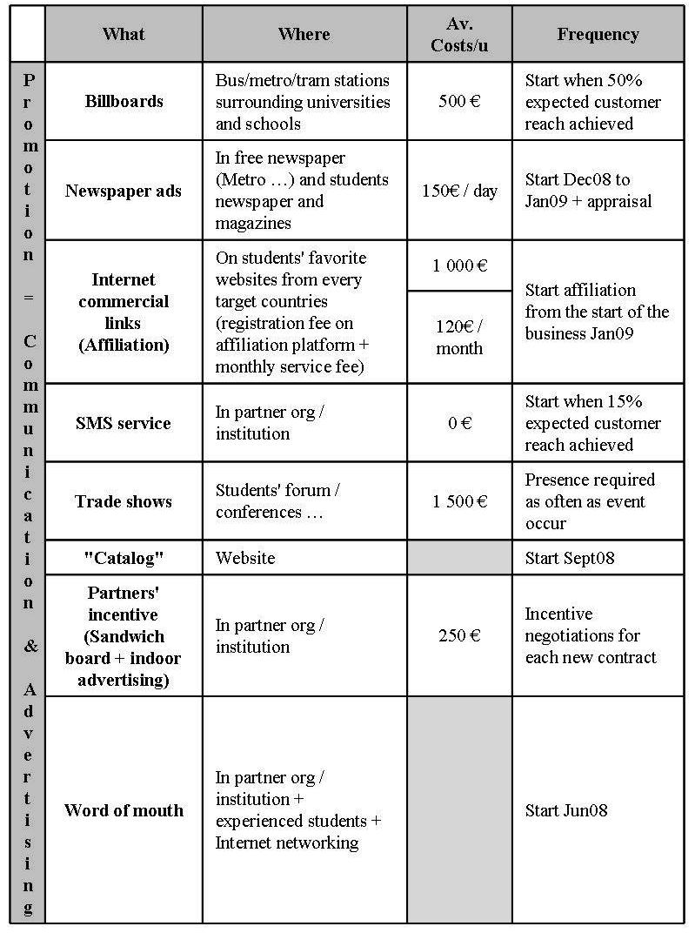
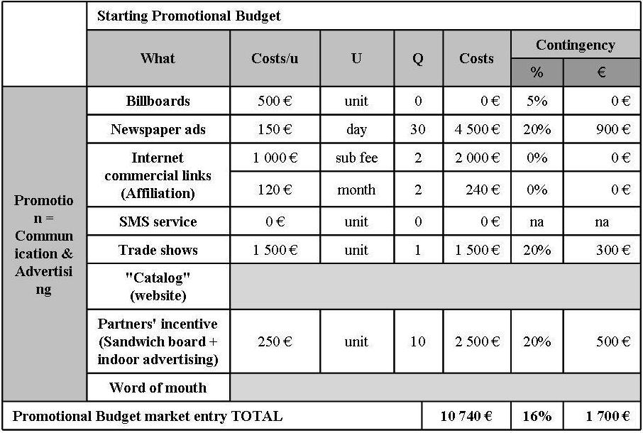
Action Plan (i)
Negotiations
Suppliers
Investors
Prospection
B2B
Website (B2C)
Company Offer
Environment
Targets Overview
Financial & Marketing
Objectives
Operational Action Plan
Capitalization &
Financial Projections
Investors’ benefits
Promotion

Slide 12
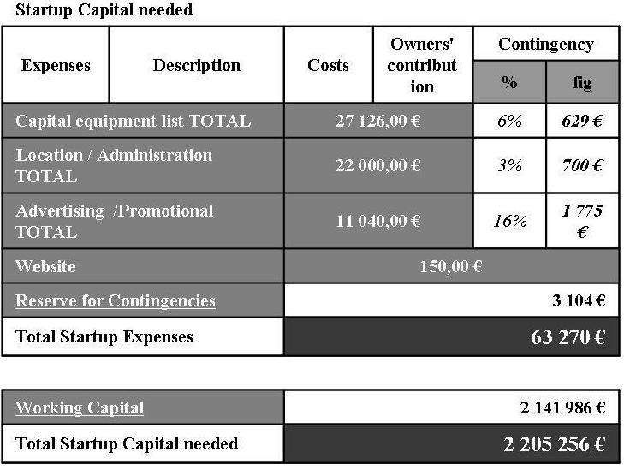
Action Plan (ii)
Startup Expenses
Company Offer
Environment
Targets Overview
Financial & Marketing
Objectives
Operational Action Plan
Capitalization &
Financial Projections
Investors’ benefits

Slide 13
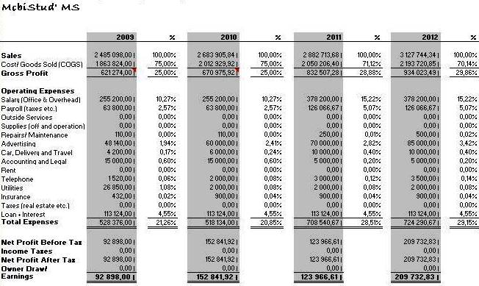
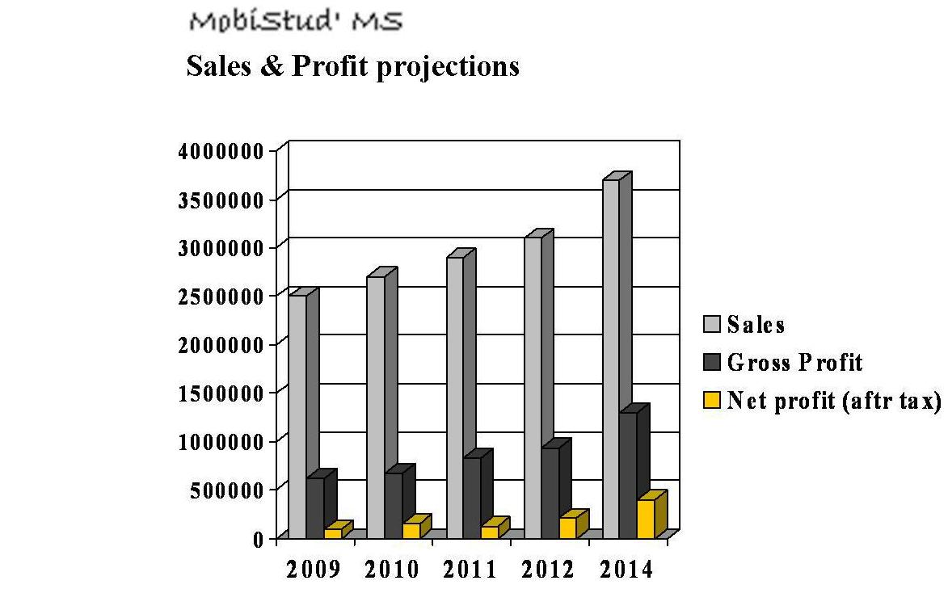
Financial Statements (i)
Profit & Loss Statements
Company Offer
Environment
Targets Overview
Financial & Marketing
Objectives
Operational Action Plan
Capitalization &
Financial Projections
Investors’ benefits

Slide 14
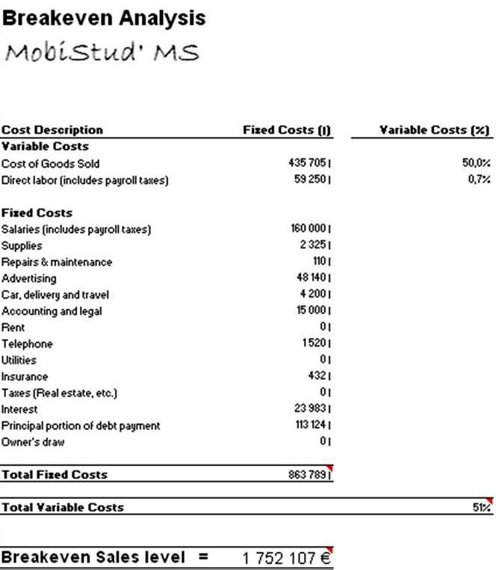
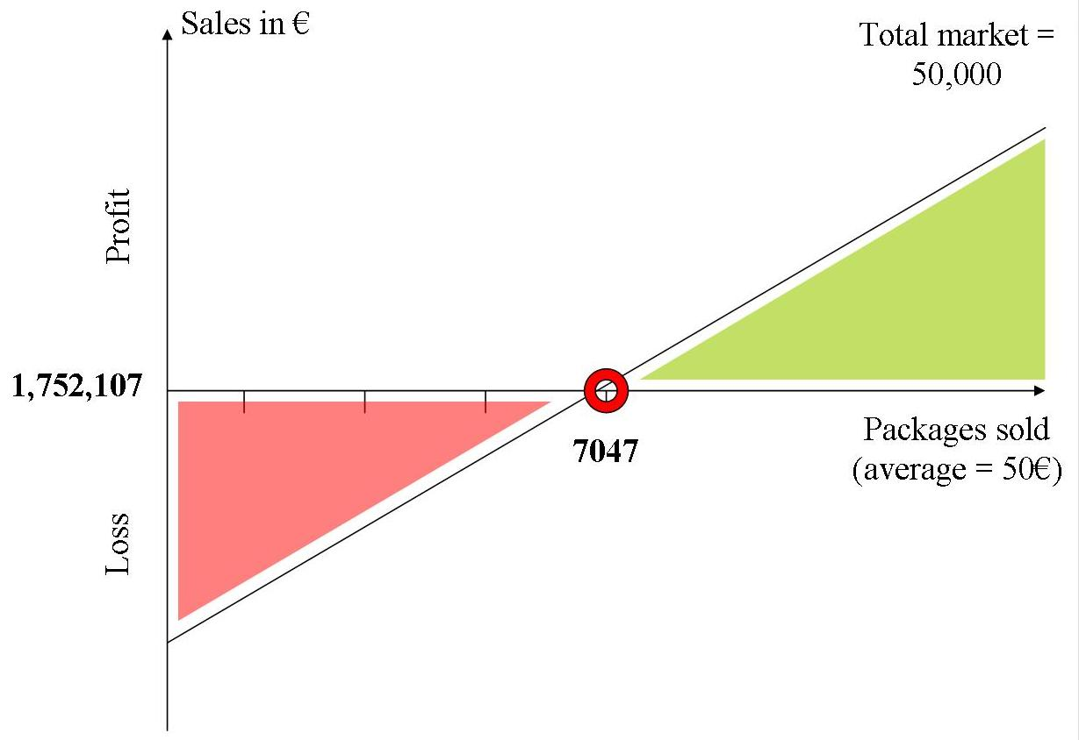
Financial Statements (ii)
Break-even Analysis
Company Offer
Environment
Targets Overview
Financial & Marketing
Objectives
Operational Action Plan
Capitalization &
Financial Projections
Investors’ benefits

Slide 15
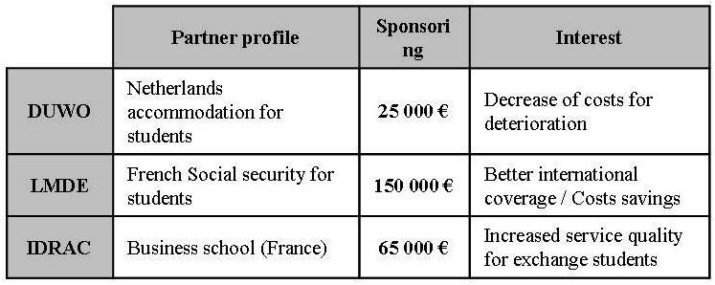
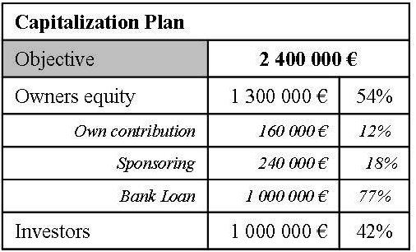
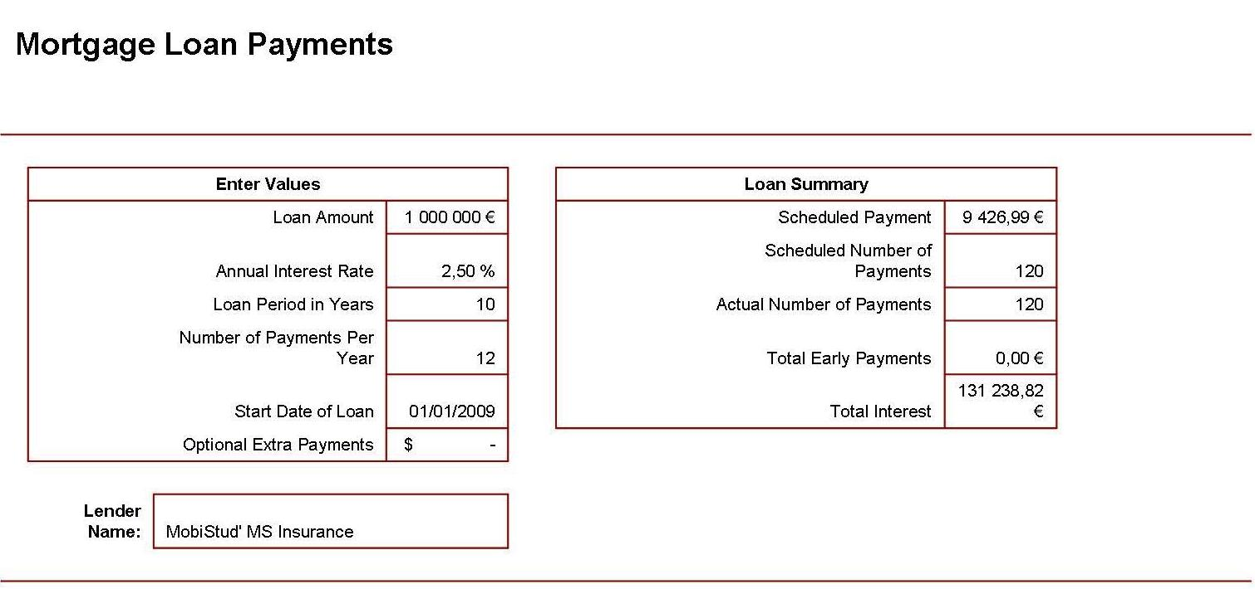
Financial Statements (iii)
Projected Capitalization
Company Offer
Environment
Targets Overview
Financial & Marketing
Objectives
Operational Action Plan
Capitalization &
Financial Projections
Investors’ benefits
And 1 Million shares issuing for a total 42% ownership and guaranteed dividends the first 5 years

Slide 16
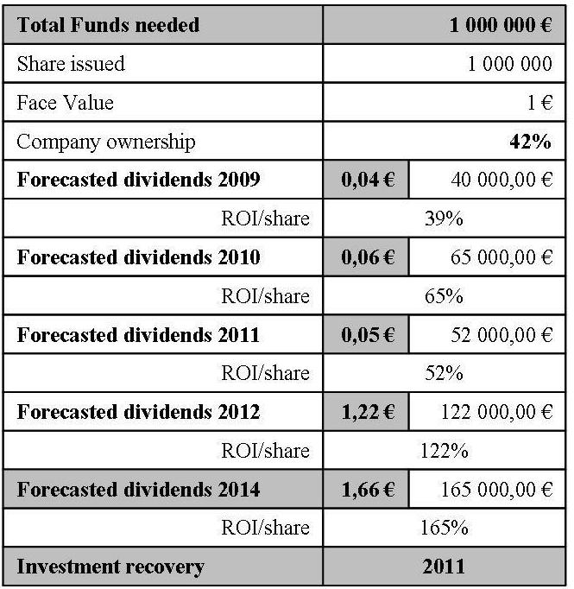
Investors’ Benefits
How You benefit from MobiStud’ investment
Company Offer
Environment
Targets Overview
Financial & Marketing
Objectives
Operational Action Plan
Capitalization &
Financial Projections
Investors’ benefits

Slide 17
Thank you for your attention
Questions are welcomed
Fred MASANGO
Jin Fan HU
Suife KISITO
Clio BERALDIN
http://www.MobiStu’MSInsurance.nl/Home

